Slide 1
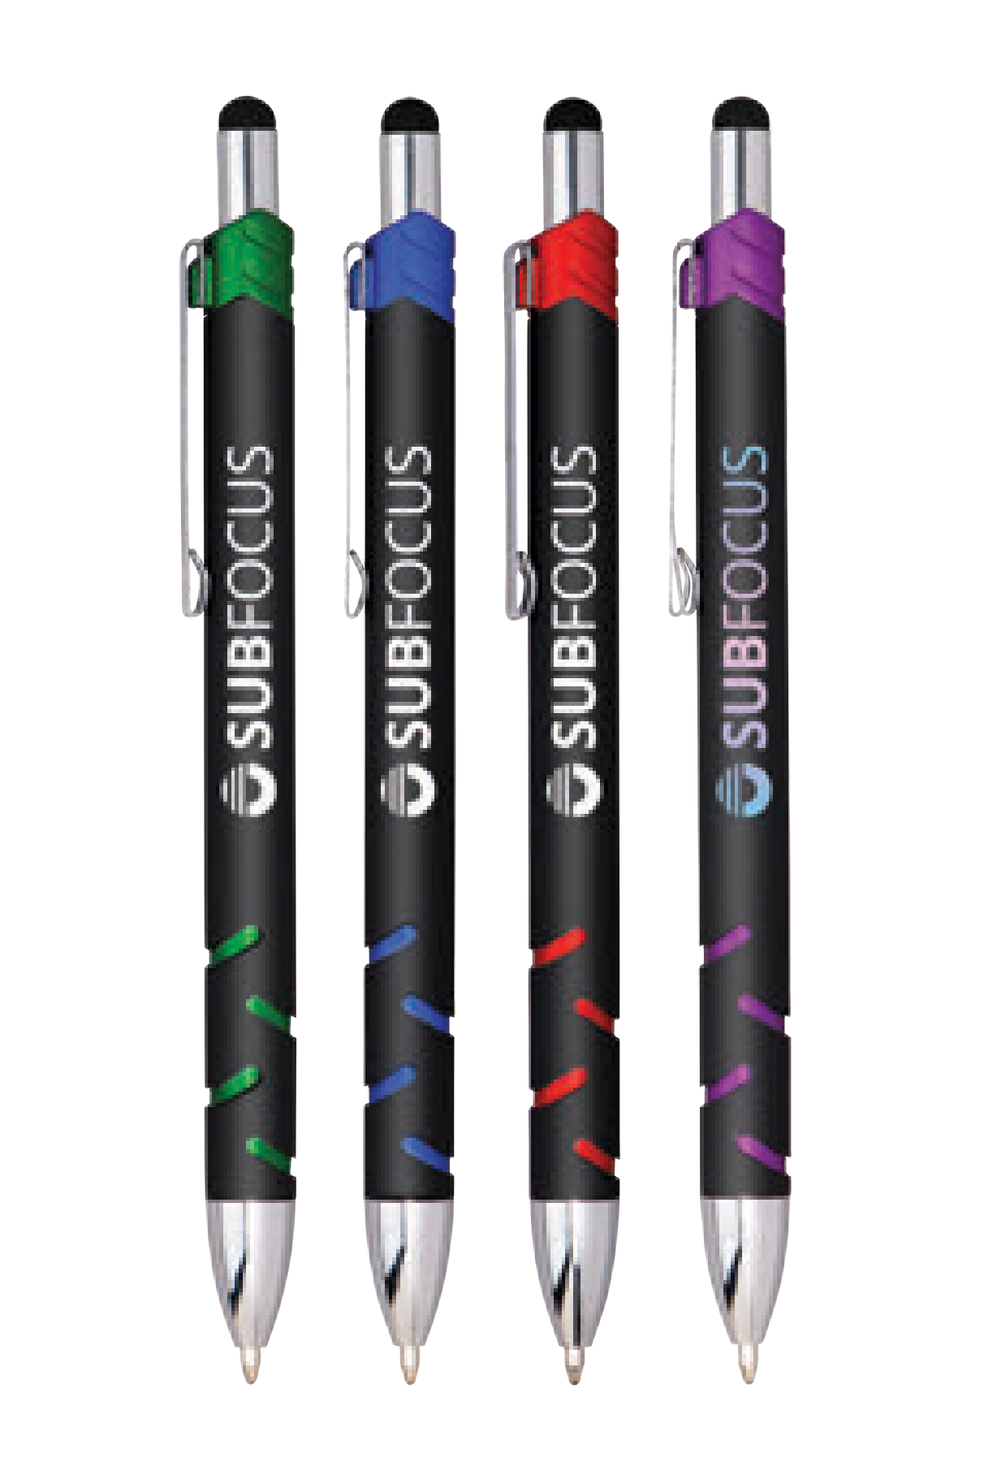


Self Promo!
100 for $64.00NET Plus, Free Setup!
Minimum Order Quantity: 100
Promo Code: CONFETTI21SP, Expires: 12/10/21
NEW
CONFETTI PURE
(Item No: 645)
Executive metal stylus pen features a soft touch finish with antimicrobial properties Contemporary details such as vivid colorful metallic trim and cut out grippers Engraved silver imprint and details contrast with matte finish
Generous imprint area makes your message stand out
Full Color
Antimicrobial
MENTION PROMO CODE: CONFETTI21SP
Distributor only self promo. Good through 12/10/21. Offer applies only to this style. FREE setup value $45 (G). Optional full color imprints available, additional charges and restrictions apply. Standard production is five business days. FOB MA. All pricing in USD and subject to change. Complete product information available.
ASI 61966

