Slide 1
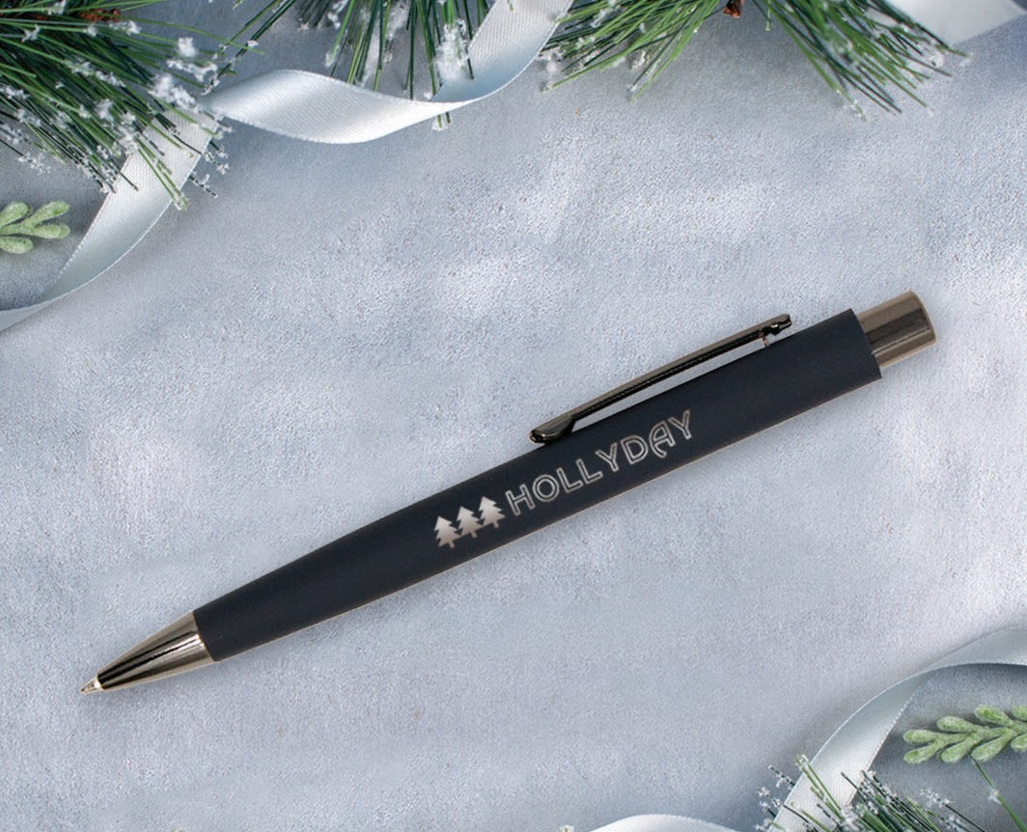

Good Tidings
Case Story
A mattress company knows how to get its’ customers excited for their new mattress delivery! Upon delivery of a new mattress the movers will provide customers with a care kit which includes our Kashmiro Comfort. The soft coating on the pen is reminiscent of that plush mattress feeling. Each time they pick up that pen, they will be reminded that they are about to get a good night's rest.
(Item No: 657)
The executive pen with the cashmere feel!
Oval shape with soft touch finish to fit comfortably in the hand
Matte corporate colors with bold gunmetal trim
Generous laser engraved bronze imprint makes your message stand out
Laser logo setup $45. FREE straight line imprint. Standard production is five business days. FOB MA. All pricing in USD and subject to change. Complete product information available.

