Slide 1
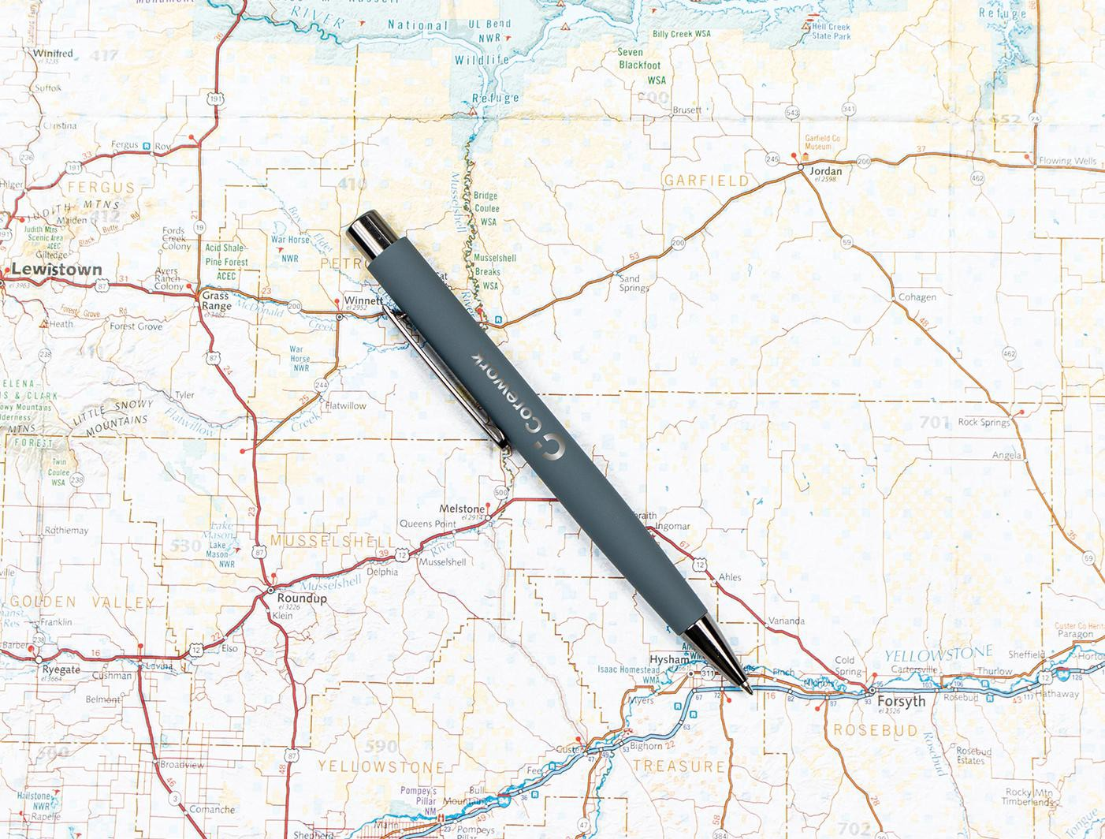
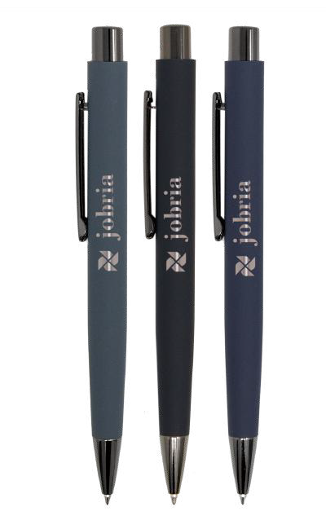
EXECUTIVE PEN
WITH THE CASHMERE FEEL!
Kashmiro Comfort
Item: 657
Now available in blue ink!
Oval shape with soft-touch finish fitting comfortably in the hand
Matte corportate colors with bold gunmetal trim
Generous laser engraved bronze imprint makes your message stand out

