Slide 1
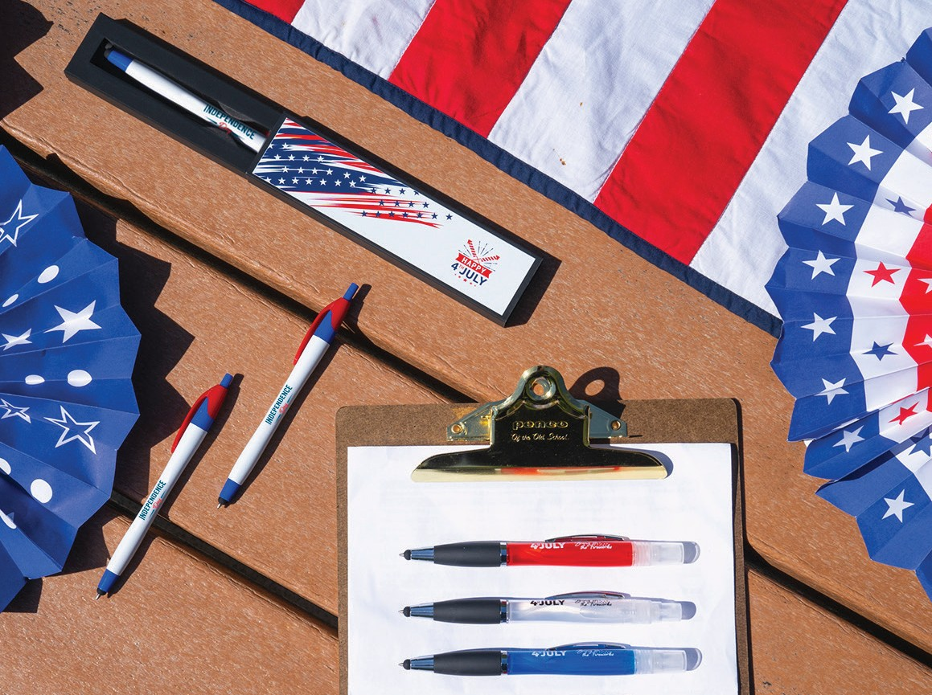





C
A
B
LET THE SPARKS FLY!
Products to celebrate red, white, and blue!
A. Aeropure Stylus
Item: 101
C. Tux Gift Box
Item: TUXBOX
B. Javalina® Classic Stylus
Item: 332
Good through 12/31/2021. 1 Color silkscreen setup $15. Standard full color imprint setup
$45. FREE 24 hour rush service available, restrictions apply. Standard production is five business days. FOB MA. All pricing in USD and subject to change. Complete product information available.

