Slide 1
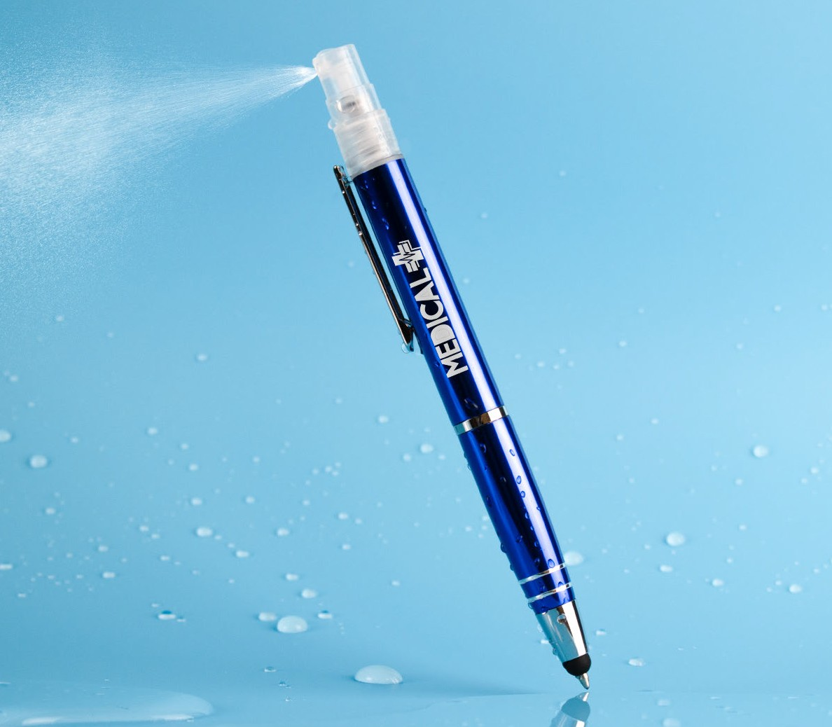
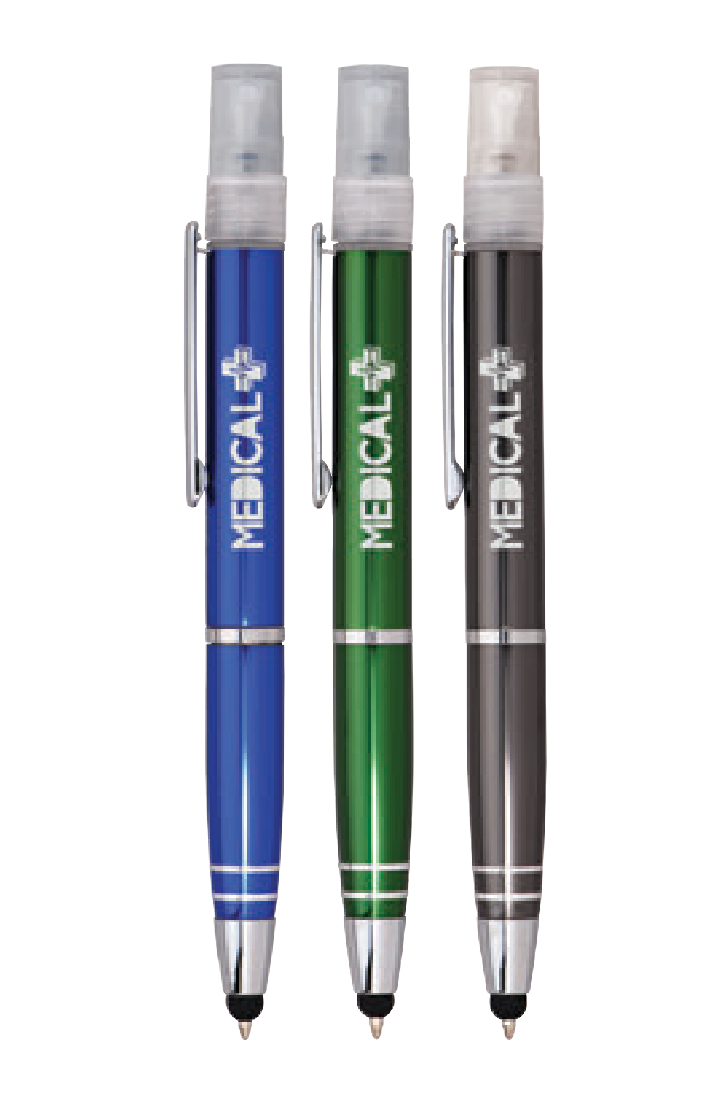

NEW
AEROPURE EXECUTIVE STYLUS
(Item No: 103)
A giftable executive metal pen, offering a citrus-scented antibacterial sanitizer spray with 62% alcohol. Features a functional stylus for a hands-free experience with touch screens.
Strong twist-action retraction.
Antimicrobial
Good through 12/31/2021. Laser setup $45. FREE straight line imprint. Standard production is five business days. FOB MA. All pricing in USD and subject to change. Complete product information available.

