Slide 1
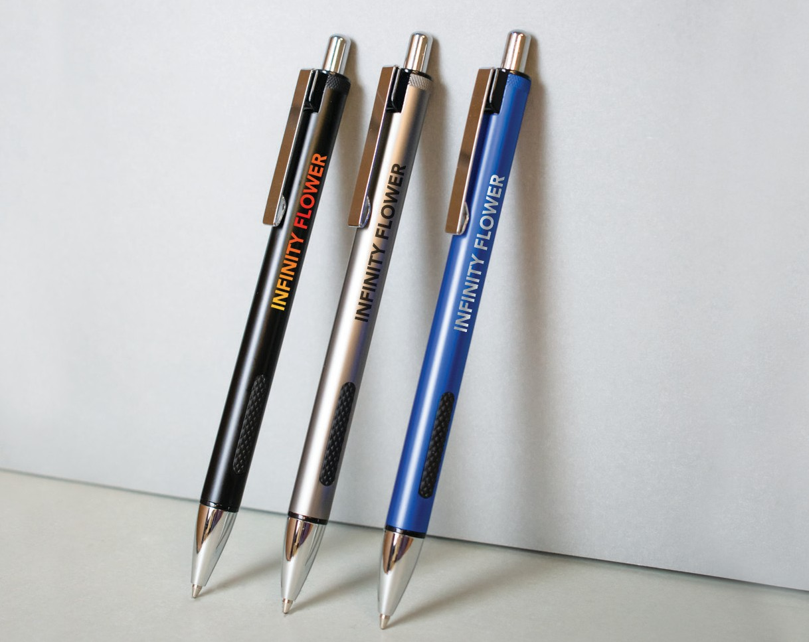


NEW
Nifty
(Item No: 641)
This stylish metal pen boasts an inset ridged grip for added comfort and the engraved silver imprint details contrast with a matte finish for a sleek look. The generous imprint area with a full-color or one-color laser-engraved message is sure to make a statement.
QTY | 250 | 500 | 1000 | 5000
 | $1.70 | $1.56 | $1.42 | $1.28 ^{EA}
Good through 12/31/2021. Laser logo setup $45, FREE straight line imprint. Optional full color imprints available, additional charges and restrictions apply. Standard production is five business days. FOB MA. All pricing in USD and subject to change. Complete product information available.

